Slide 1
Quadruple Cross-Coupled Latch-Based 10T and 12T SRAM Bit-Cell Designs
Prafful Choudhary(MT2021523)
Aakarsh Dev (MT2021501)
Rohit Gaykhe (MT2021526)

Slide 2

SECTION
PROBLEM STATEMENT
OVERVIEW
PROPOSED DESIGN
SEU
PRECHARGE & DIFFERENTIAL AMPLIFIER CIRCUIT
10-T SRAM CELL
12-T SRAM CELL
RESULTS

Slide 3
PROBLEM STATEMENT
As both Voltage and Cell Size are reduced with each new process node.
The internal Capacitance is also reduced makes the critical charge needed to upset the logic state of circuit node much smaller , resulting in increase vulnerability of SEE.
High Energy Cosmic rays and Solar particles react with the upper atmosphere generating high energy proton & neutron that showers to the ground.
E-H Pair generated by interaction of an energetic charged particle with semiconductor atoms corrupts the stored data in memory cell.

Slide 4
LIMITATION OF SRAM
1): By applying near/ subthreshold voltage in SRAM Designs
As Supply Voltage Delay of SRAM at higher rate than CMOS Logic Circuit Delay.
Low Voltage READ operation lead to destruction of stored data in SRAM bitcells.
Write Operation suffers from a higher rate of failure at Low Supply Voltages.
2): Due to the possibility of SRAM being affected by SEU.

Slide 5

IS THIS A NEW PROBLEM ?
NO!
In Late 1970’s SOFT ERROR problem gained widespread attention when DRAM’s circuit began to sign of apparently random failures.
Predictably induce bit flips in commodity DRAM chips
>80% of the tested DRAM chips are vulnerable
Unlike DRAM’s , SRAM memories and SRAM-based programmable logic devices are also subject to the same effects.
SRAM’s are constructed of cross coupled devices , far less CAPACITANCE in each cell. the SRAM cell capacitance continues to decrease, making the cell even more vulnerable to more types of (lower energy) particles.

Slide 6
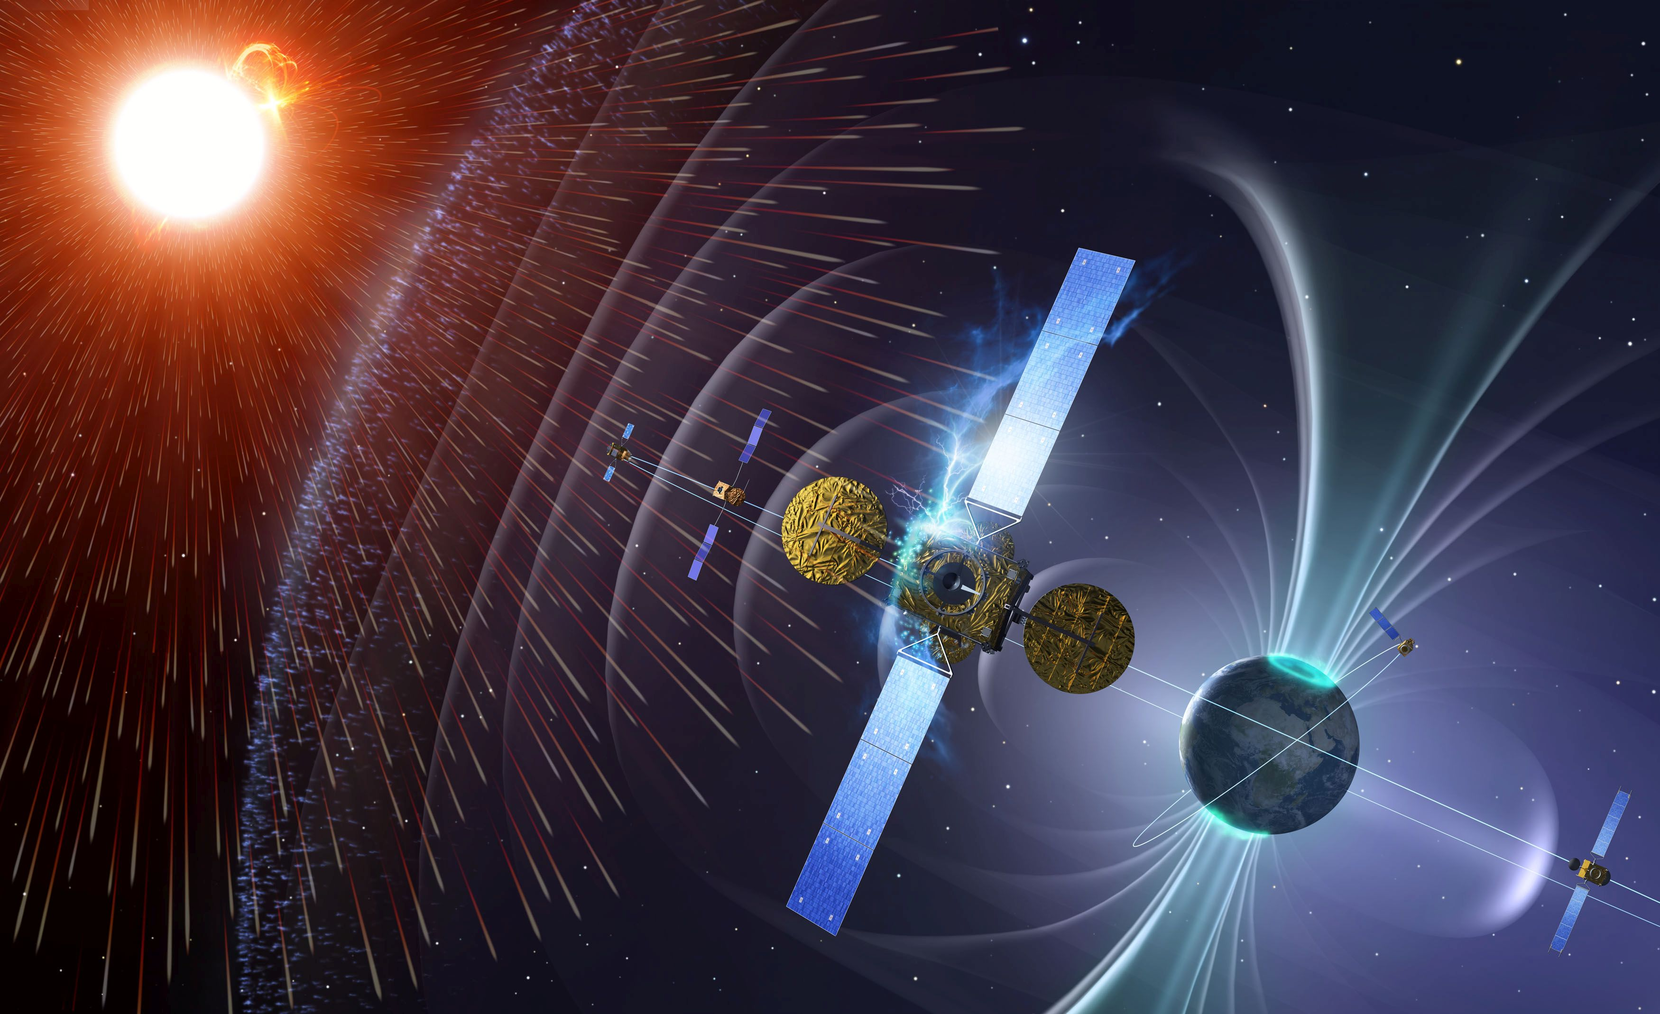
OVERVIEW
IBM demonstrated that at an altitude as low as 10,000 feet, SEU effects were already 14 times higher than at sea.
In 2000, Sun's UltraSPARC II workstations were crashing at an alarming rate.
The April 2002 (IRPS), held in Dallas, had a special focused session discussing, "Radiation Induced Soft Errors in Silicon Components and Computer Systems.
This problem will continue to worsen as devices increase in density and geometries continue to shrink. 130 nanometer and smaller SRAM geometries are particularly sensitive to these problems.
https://www.esa.int/var/esa/storage/images/esa_multimedia/images/2018/11/space_situational_awareness_space_weather/18246476-2-eng-GB/Space_Situational_Awareness_Space_Weather.jpg

Slide 7
PROPOSED DESIGN
Utilizing two p-type and two n-type latch structures, quadruple cross-coupled storage cells (QUCCE) 10-T and 12-T are proposed.
QUCCE 10-T and 12-T have better soft error tolerance, time performance, read static noise margins, and hold static noise margins.
QUCCE 10-T also has lower costs in terms of area and leakage power.
QUCCE 12-T saves more than 50% the read access time compared with most of the referential cells including the 6T, making it suitable for high speed SRAM designs.

Slide 8
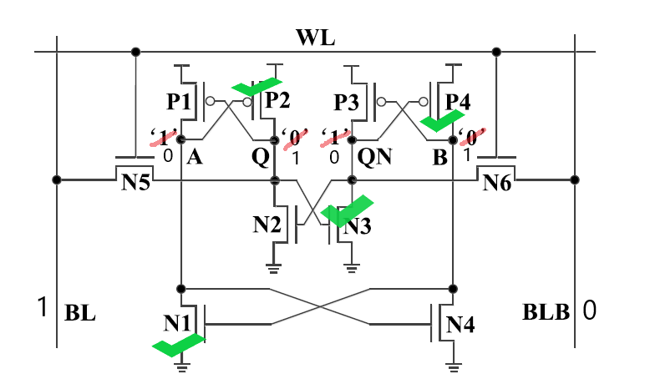
10-T SRAM CELL
WRITE 1

Slide 9
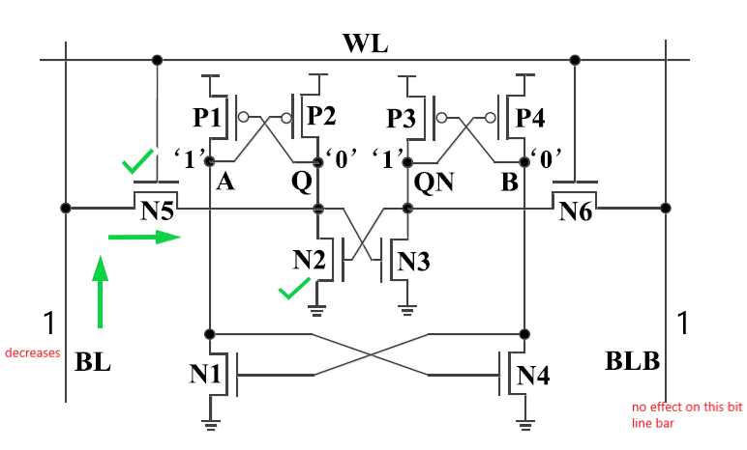
10-T SRAM CELL
READ 0

Slide 10
10T-SRAM WIDTH SPECIFICATION
NMOS | Width(nm) | PMOS | Width(nm)
N1 | 120 | P1 | 265
N2 | 250 | P2 | 140
N3 | 250 | P3 | 140
N4 | 120 | P4 | 265
N5 | 140
N6 | 140
CR, the cell ratio defined as (WN2/LN2)/(WN5/LN5) or (WN3/LN3)/(WN6/LN6) for read stability, is set to be 1.8.
PR1, defined as (WP2/LP2)/(WN5/LN5) or (WP3/LP3)/(WN6/LN6) for write-ability, is set to be 1
PR2, defined as (WP4/LP4)/(WN4/LN4) or (WP1/LP1)/(WN1/LN1), is set to be 2.2.

Slide 11
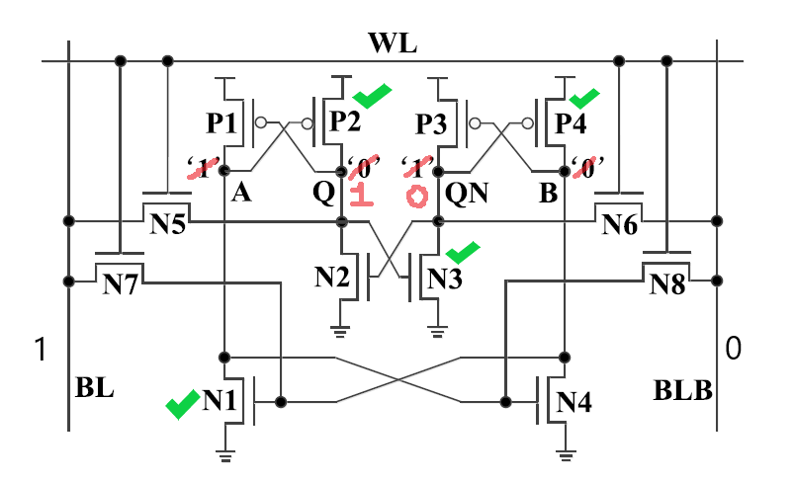
Schematic of QUCCE 12T
WRITE-1

Slide 12
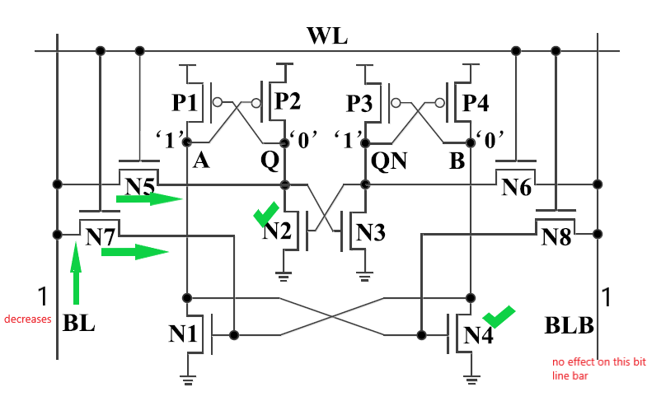
Schematic of QUCCE 12T
READ-0

Slide 13
12T-SRAM WIDTH SPECIFICATION
NMOS | Width(nm) | PMOS | Width(nm)
N1 | 510 | P1 | 280
N2 | 510 | P2 | 280
N3 | 510 | P3 | 280
N4 | 510 | P4 | 280
N5 | 280
N6 | 280
N7 | 280
N8 | 280
CR, defined as (WN2/LN2)/(WN5/LN5), (WN4/LN4)/(WN7/LN7), (WN3/LN3)/(WN6/LN6), or (WN1/ LN1)/(WN8/LN8) for read stability, is set to be 1.8.
PR, defined as (WP3/LP3)/(WN6/LN6), (WP1/LP1)/(WN8/LN8), (WP2/LP2)/(WN5/LN5), or (WP4/LP4)/(WN7/LN7) for write ability, is set to be 1.

Slide 14
SET(SINGLE EVENT TRANSIENT )
Single Event Transients (SETs) are caused by a single energetic particle.
If a SET propagates through digital circuitry and results in an incorrect value being latched in a sequential logic unit, it is then considered an SEU.
Condition for SET to occur:
An energetic particle strikes drain terminal of MOSFET.
The MOSFET should be OFF.
The MOSFET should be in reverse biased (reverse biased junctions collect charge due to the influence of the electric potential gradient).

Slide 15
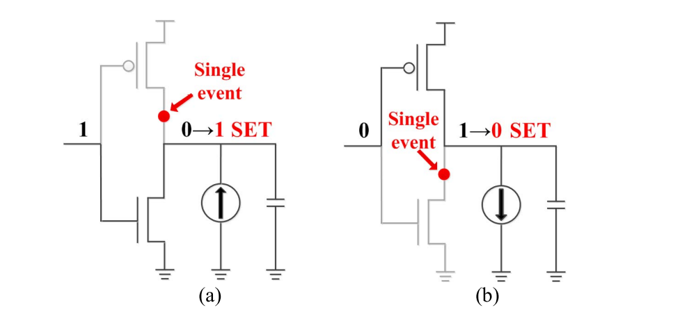
MODELLING SINGLE EVENT TRANSIENT: We have to inject transient fault through double exponential current source as described in literatures
(a) generation of a positive transient pulse
(b) generation of a negative transient pulse

Slide 16
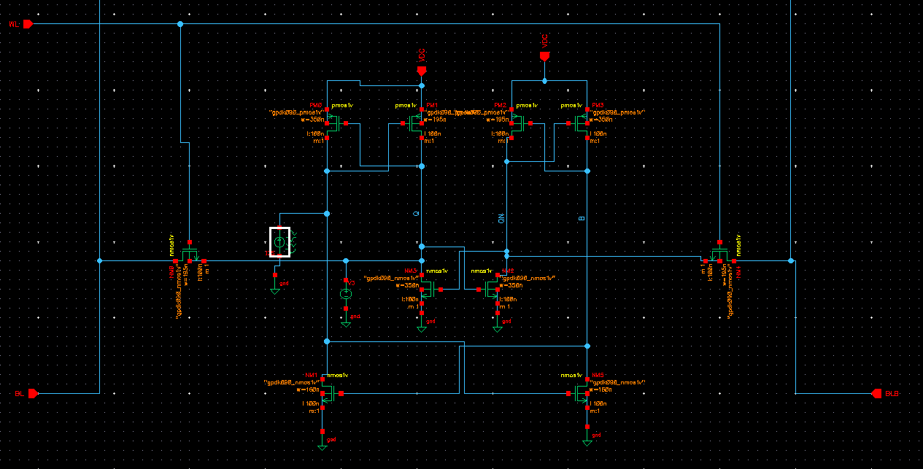
SCHEMATIC WITH SEU

Slide 17
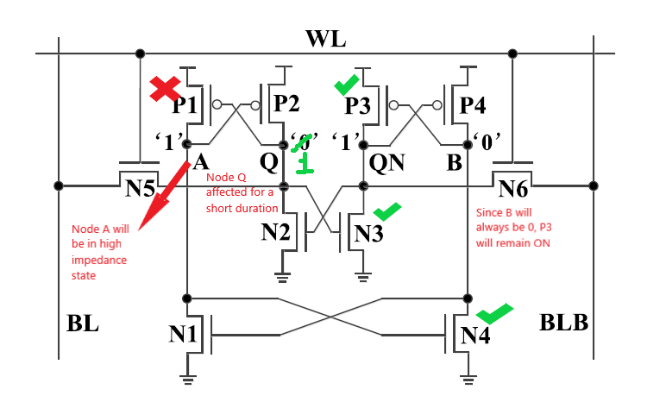
10-T (SEU AT Q)

Slide 18
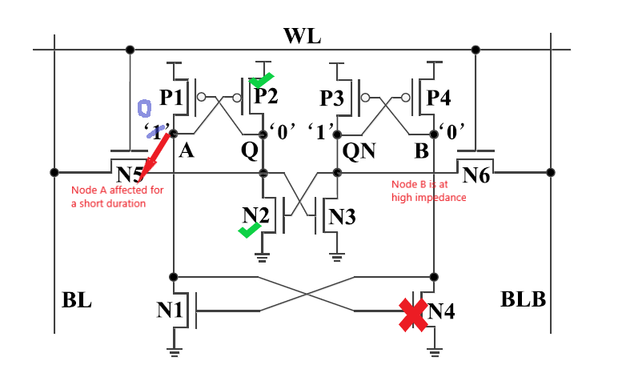
10-T (SEU AT A)

Slide 19
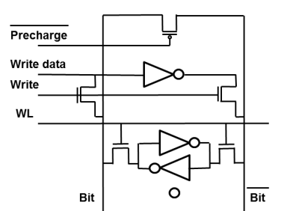
Write Circuitry

Slide 20
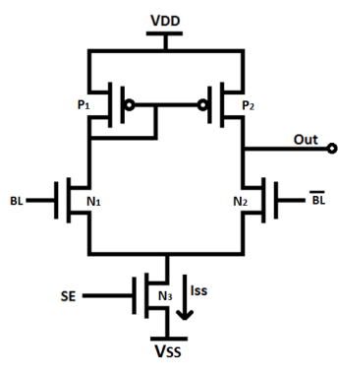
Sense Amplifier Design
The sense amplifier may be enabled at the same time as the wordline during a read cycle, making timing requirements for this amplifier very easy.
The differential amplifier is resistant to supply noise variations due to its ability to reject common mode voltages; only differences between the inputs are amplified.
Any noise that appears on both inputs of the amplifier will not affect the output.

Slide 21
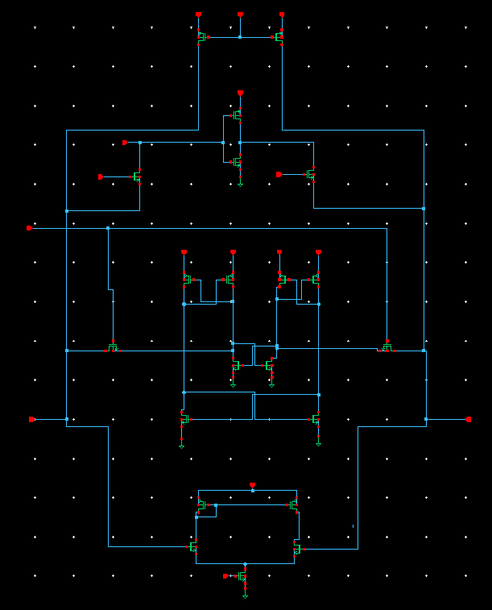
10-T FULL CIRCUITARY

Slide 22
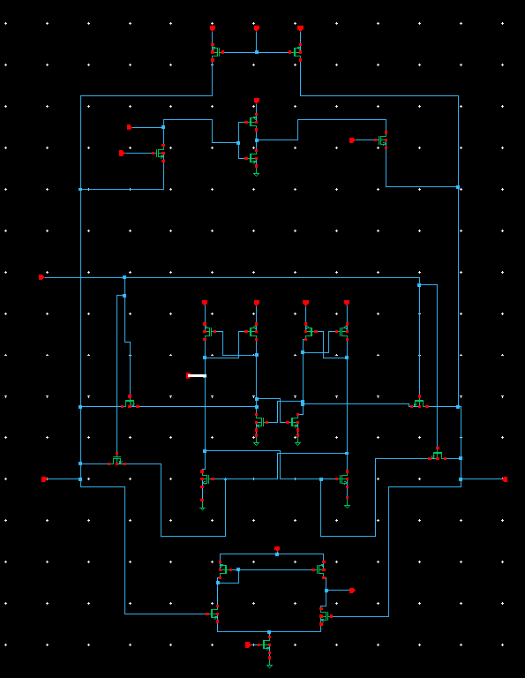
12-T FULL CIRCUITARY

Slide 23
RESULTS

Slide 24
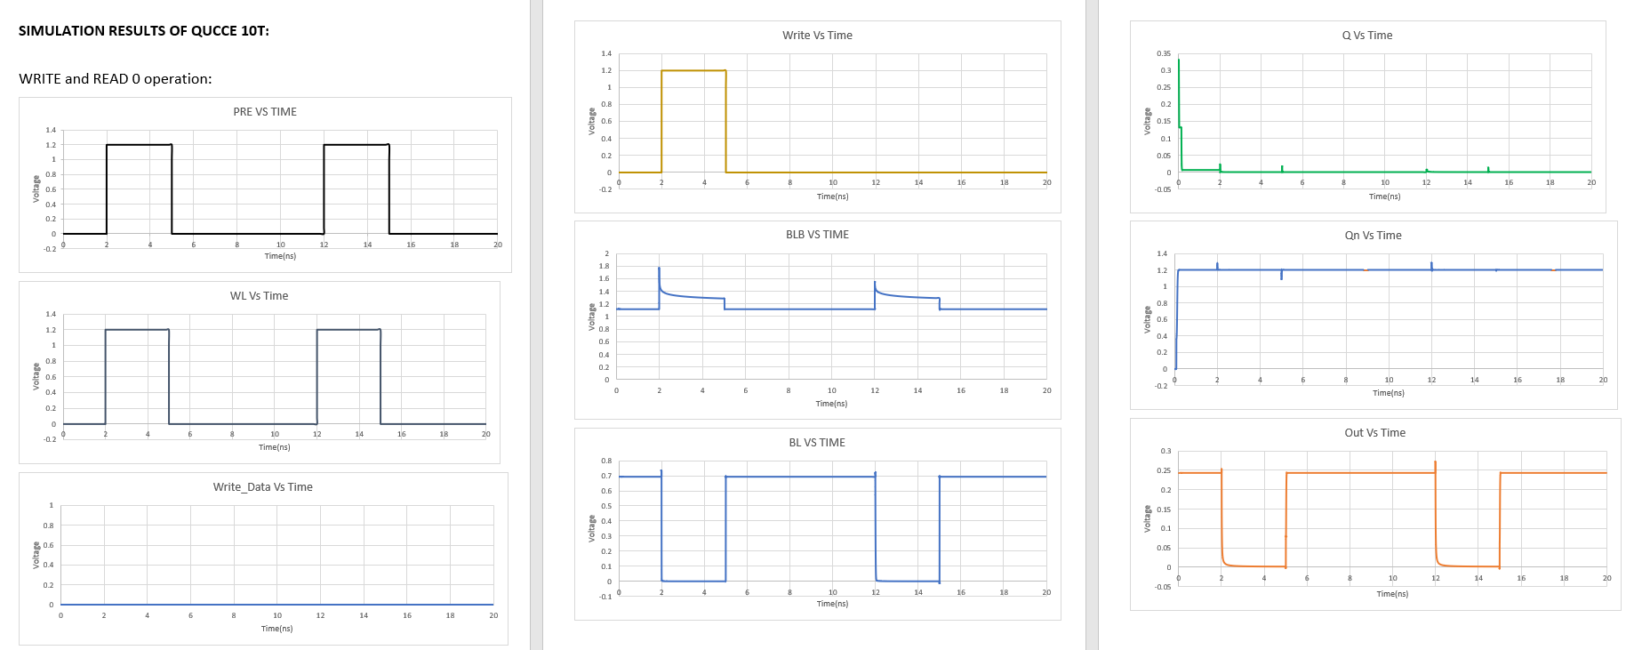

Slide 25
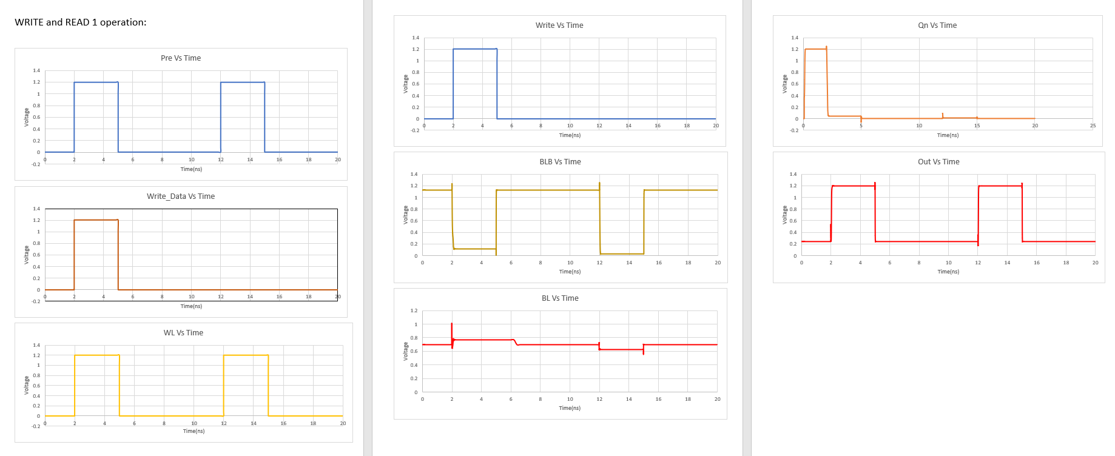

Slide 26
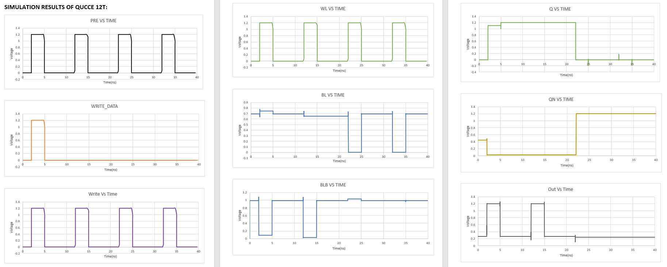

Slide 27
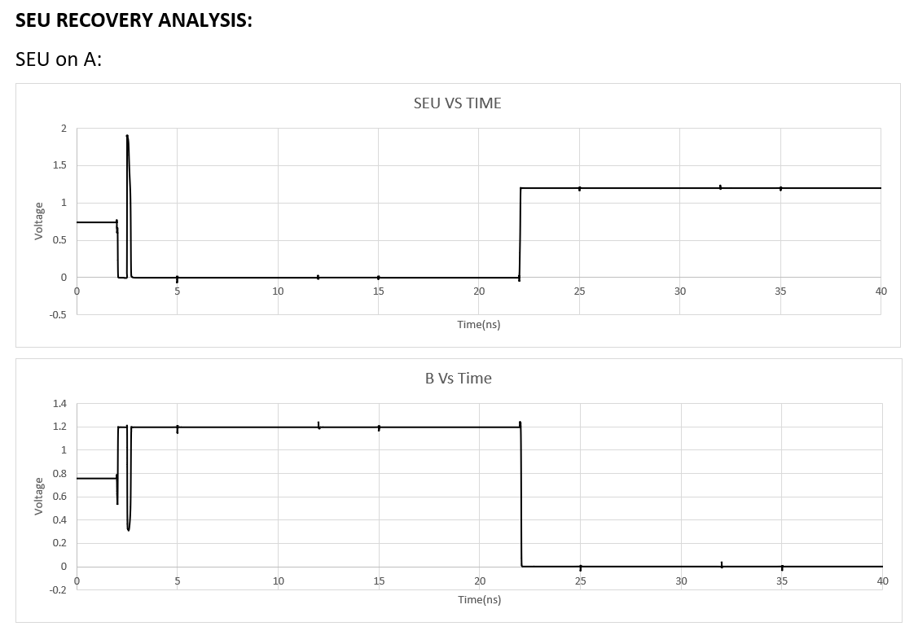
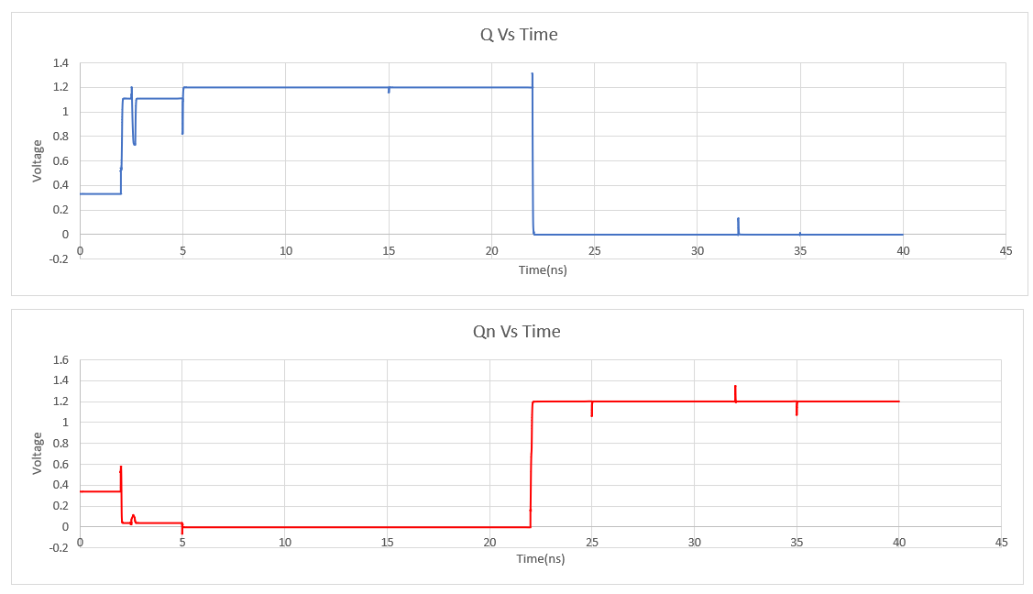

Slide 28
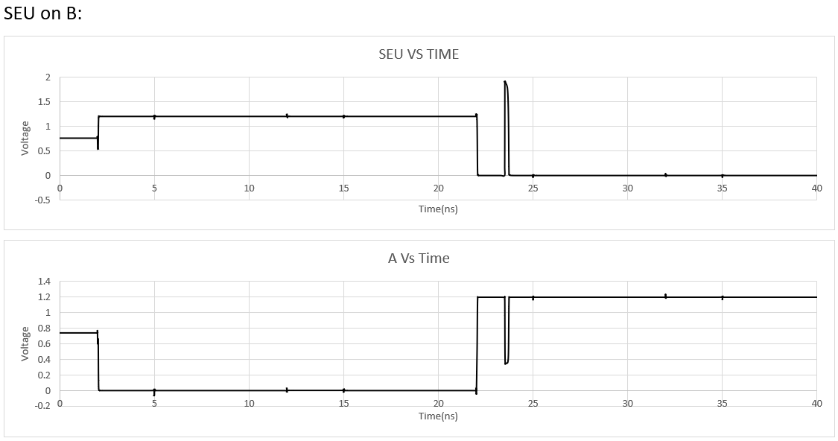
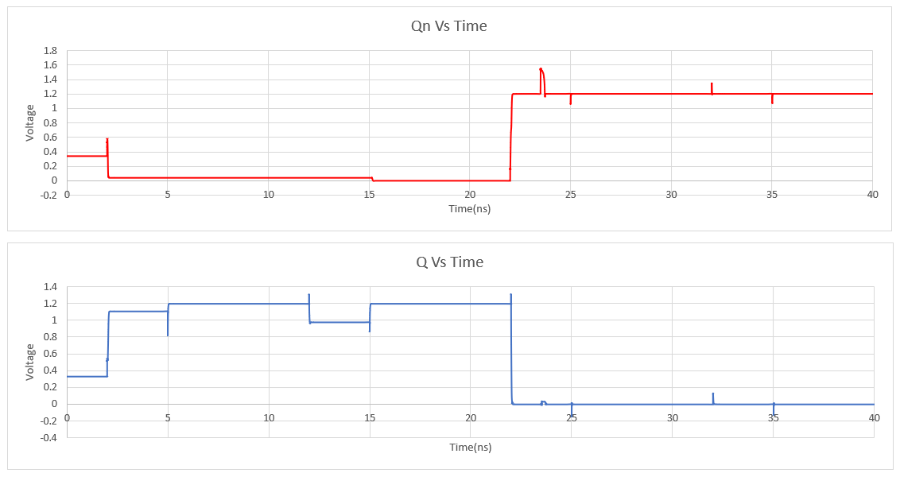

Slide 29
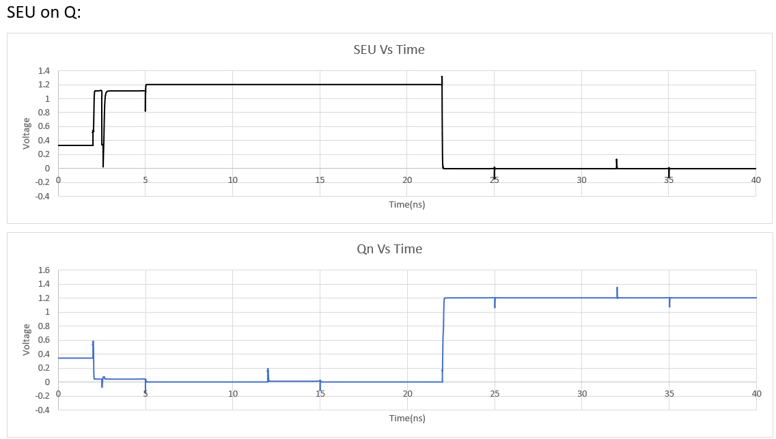
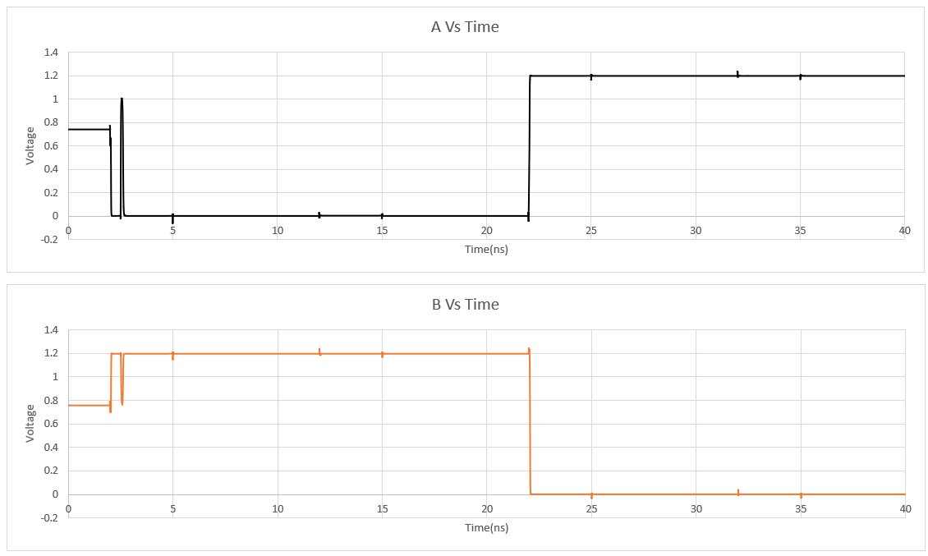

Slide 30
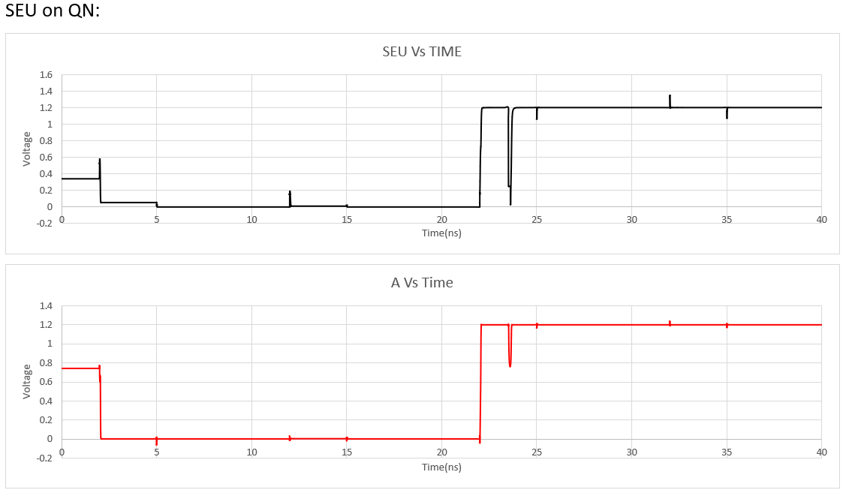
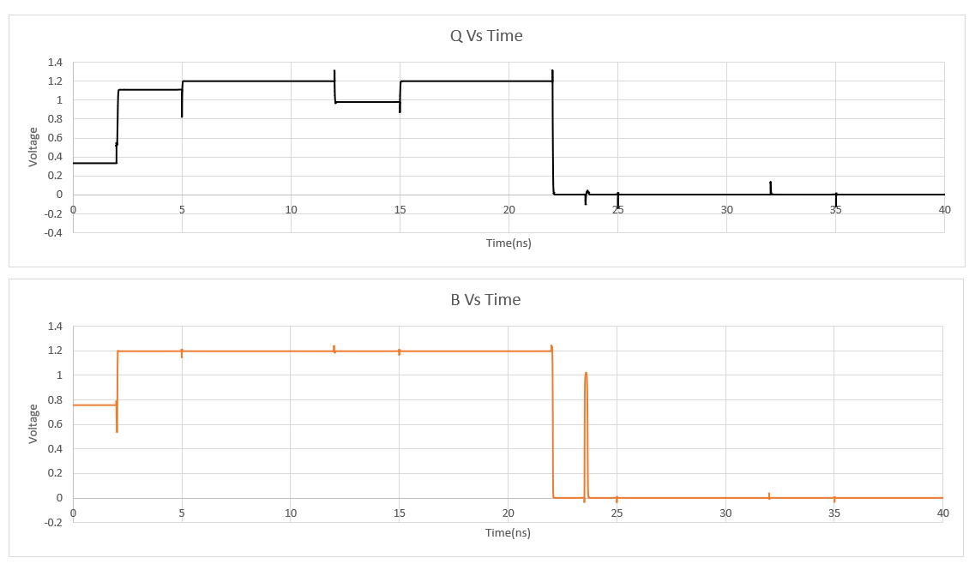

Slide 31
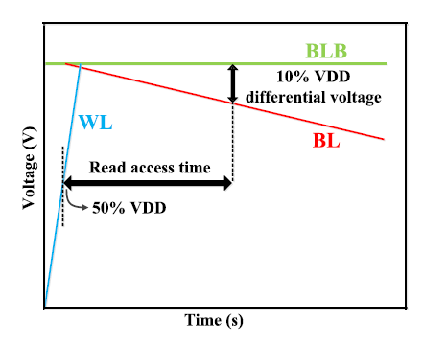
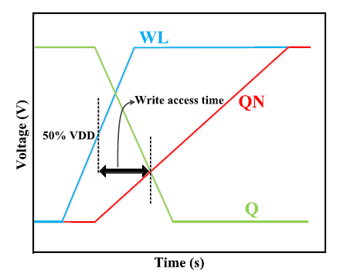
READ & WRITE ACCESS TIME

Slide 32
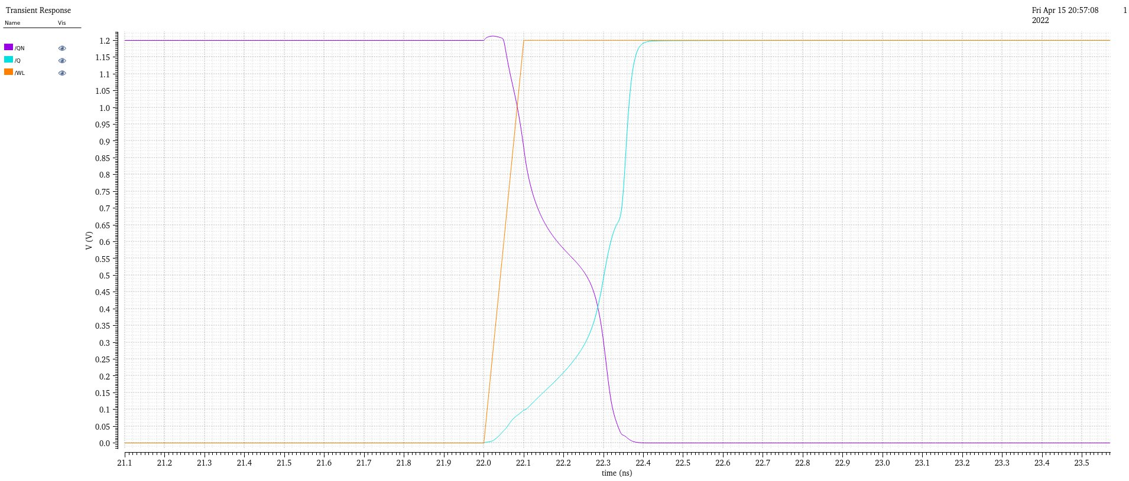
WRITE ACCESS TIME

Slide 33
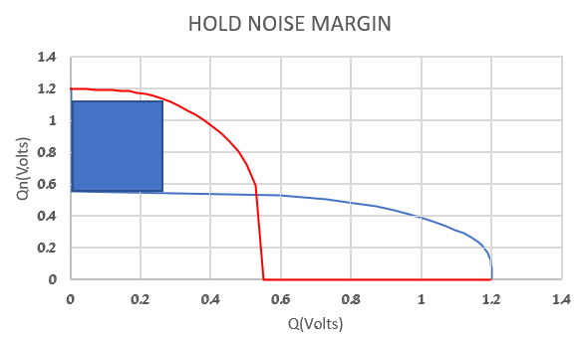
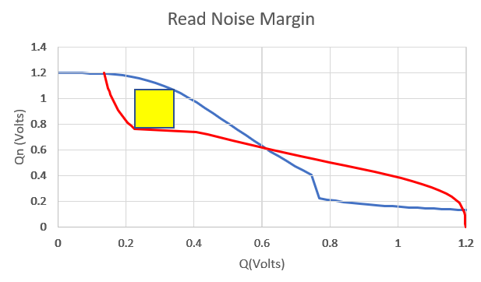
HOLD STATIC NOISE MARGIN
READ STATIC NOISE MARGIN

Slide 34
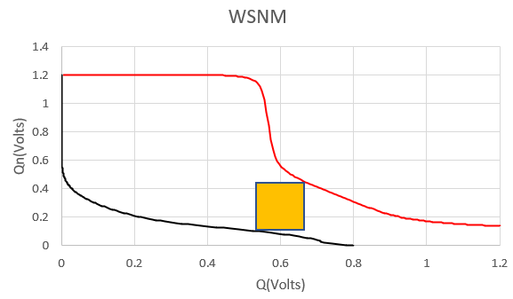

Slide 35
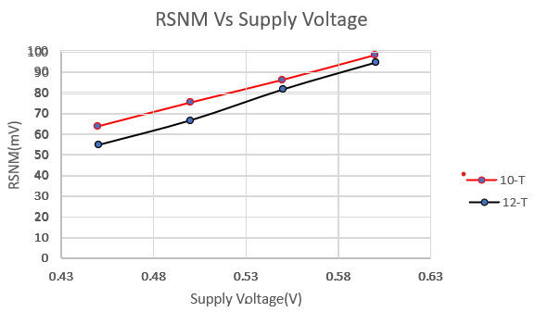
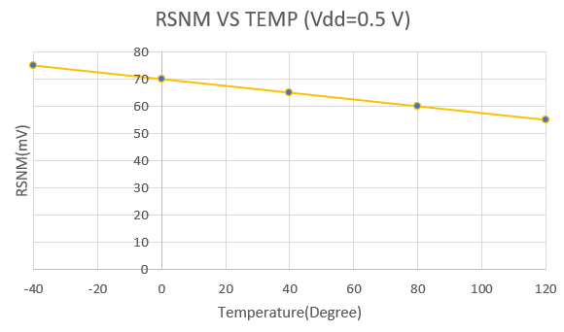

Slide 36
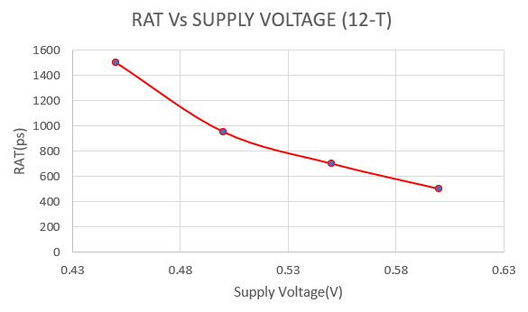
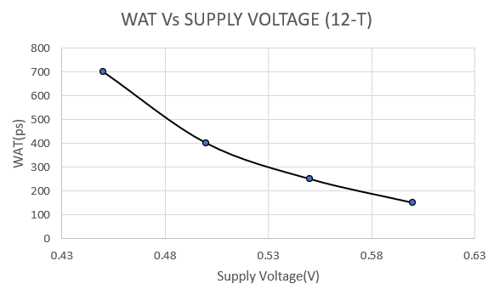

Slide 39
RSNM Vs PROCESS CORNER VARIATION
PROCESS CORNER | RSNM(12-T)(mV)
SS | 70.53
SF | 103.61
FS | 24.94
FF | 42.89
NN | 68.25

Slide 40
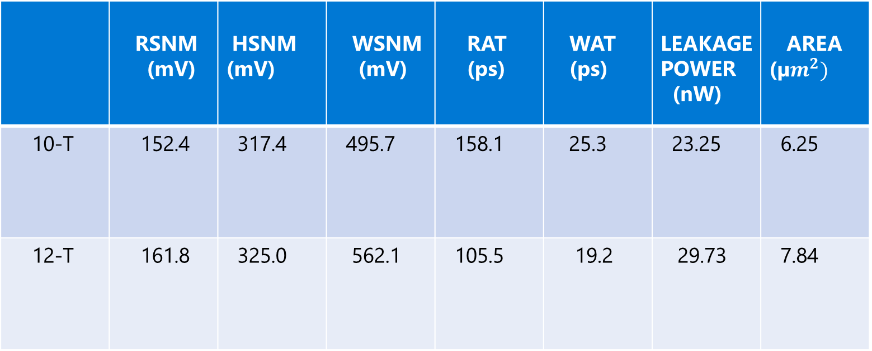
REPORT
 | RSNM (mV) | HSNM (mV) | WSNM (mV) | RAT (ps) | WAT (ps) | LEAKAGE POWER (nW) | AREA (µ$m^{2})$
10-T | 152.4 | 317.4 | 495.7 | 158.1 | 25.3 | 23.25 | 6.25
12-T | 161.8 | 325.0 | 562.1 | 105.5 | 19.2 | 29.73 | 7.84

Slide 41
Resources
M. Alioto, “Ultra-low power VLSI circuit design demystified and explained: A tutorial,” IEEE Trans. Circuits Syst. I, Reg. Papers, vol. 59, no. 1, pp. 3–29, Jan. 2012.
A. T. Do et al., “0.2 V 8T SRAM with PVT-aware bitline sensing and column-based data randomization,” IEEE J. Solid-State Circuits, vol. 51, no. 6, pp. 1487–1498, Jun. 2016.
M. T. Bohr and I. A. Young, “CMOS scaling trends and beyond,” IEEE Micro, vol. 37, no. 6, pp. 20–29, Dec. 2017.
J. Jiang et al., “Low-cost single event double-upset tolerant latch design,” Electron. Lett., vol. 54, no. 9, pp. 554–556, May 2018.
A. T. Do et al., “0.2 V 8T SRAM with PVT-aware bitline sensing and column-based data randomization,” IEEE J. Solid-State Circuits, vol. 51, no. 6, pp. 1487–1498, Jun. 2016.
I.-S. Jung, Y.-B. Kim, and F. Lombardi, “A novel sort error hardened 10T SRAM cells for low voltage operation,” in Proc. IEEE 55th Int. MWSCAS, Aug. 2012, pp. 714–717.

Slide 42
Questions & answers

